Slide 1

Department of Computer Science & Engineering IOT based Sustainable Green house monitoring System
Maisammaguda, Kompally,
Medchal - Malkajgiri District Hyderabad - 500100, Telangana State
www.mallareddyuniversity.
(Telangana State Private Universities Act No. 13 of 2020 &
G.O.Ms. No. 14, Higher Education (UE) Department)
Batch No.: 13 1. M . Anirudh – 2011CS010325
2. T . Arjun – 2011CS010289
3. N . Tejas – 2011CS010278
4. V . Jaswanth – 2011CS010308

Slide 2
CONTENTS
Introduction
Problem Statement
Proposed System
Components
Circuit
Output

Slide 3
PROBLEM STATEMENT
Traditional greenhouse management faces challenges such as inefficient resource utilization, lack of real-time monitoring, and dependence on non-renewable energy sources.
This project addresses these issues by developing an IoT-based sustainable greenhouse monitoring system, aiming to improve overall efficiency, reduce environmental impact, and promote eco-friendly agricultural practices?

Slide 4
PROPOSED SYSTEM
The proposed solution involves the integration of IoT devices to monitor key environmental factors in a greenhouse.
The Arduino Uno acts as the central controller, collecting data from the DHT11 sensor for temperature and humidity, the soil moisture sensor for soil condition, and controlling the 12V DC fan via the relay module for ventilation.
The buck converter manages power efficiency, while a solar panel and converter contribute to sustainability by harnessing solar energy.

Slide 5
COMPONENTS
Arduino UNO is a micro-controller board based on the Atmega328P. It is used to integrate into a variety of electronic projects
Price : ₹450
DHT11 is a commonly used Temperature and humidity sensor that comes with a dedicated NTC to measure temperature and an 8-bit microcontroller to output the values of temperature and humidity as serial data.
Price : ₹210
ESP2866(Wifi Module) is a self contained SOC with integrated TCP/IP protocol stack that can give any microcontroller access to your WiFi network. The ESP8266 is capable of either hosting an application or offloading all networking functions from another application processor.
Price : ₹450

Slide 6
COMPONENTS
Moisture Sensor Measures the moisture content in the soil for effective irrigation control,Analog output for indicating soil moisture levels,Enables efficient water usage in greenhouse operations . Price : ₹200
12V DC fan Provides ventilation and temperature regulation within the greenhouse,Essential for maintaining optimal environmental conditions for plant growth,Controlled and automated using the relay module. Price: ₹199
LCD Display(2.4 inch TFT) The 2.4-inch TFT display, communicating over I2C, provides a visual interface for real- time monitoring. It displays sensor data and system status, enhancing user interaction with the monitoring System.
Price: ₹675

Slide 7
COMPONENTS
Solar panel and converterThe solar panel and converter form the sustainable power supply for the greenhouse monitoring system. The solar panel harnesses solar energy, converting it into electrical power. The converter then adjusts this power to match the system's requirements. This integration reduces dependence on traditional power sources, making the system more environmentally friendly and cost-effective in the long run. Price : ₹1450
Water pump and pipes The water pump, a critical component in the system, is utilized for automated irrigation triggered by high humidity levels. Controlled by the Arduino Uno through the relay module, it ensures precise and timely sprinkling to maintain optimal soil moisture conditions,
Price: ₹550

Slide 8
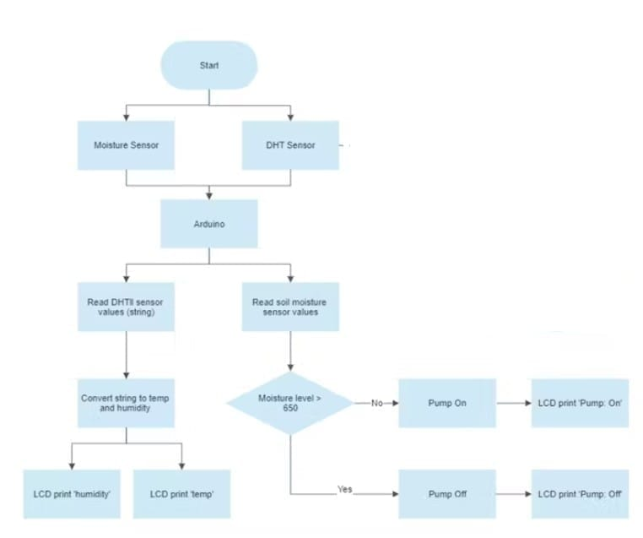
FLOW CHART

Slide 9
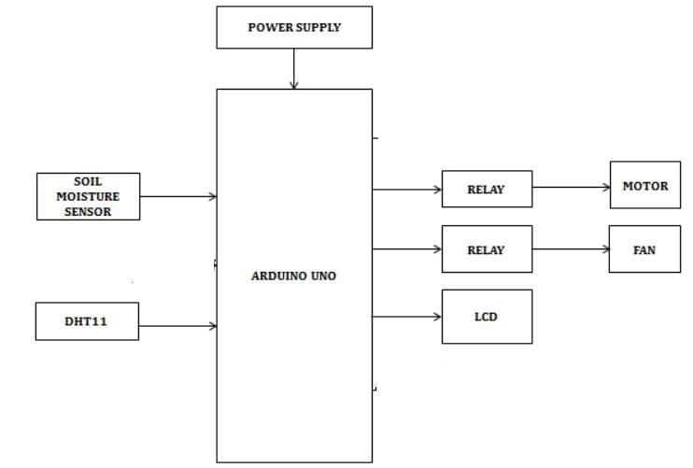
Block Diagram

Slide 10
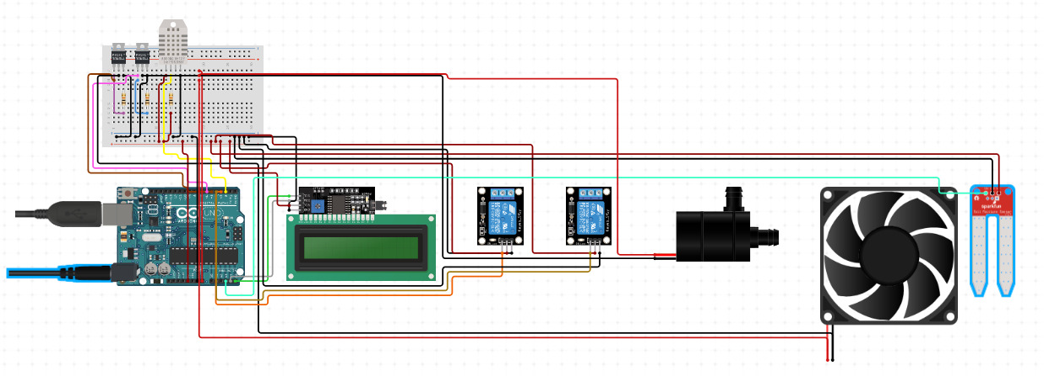
CIRCUIT

Slide 11
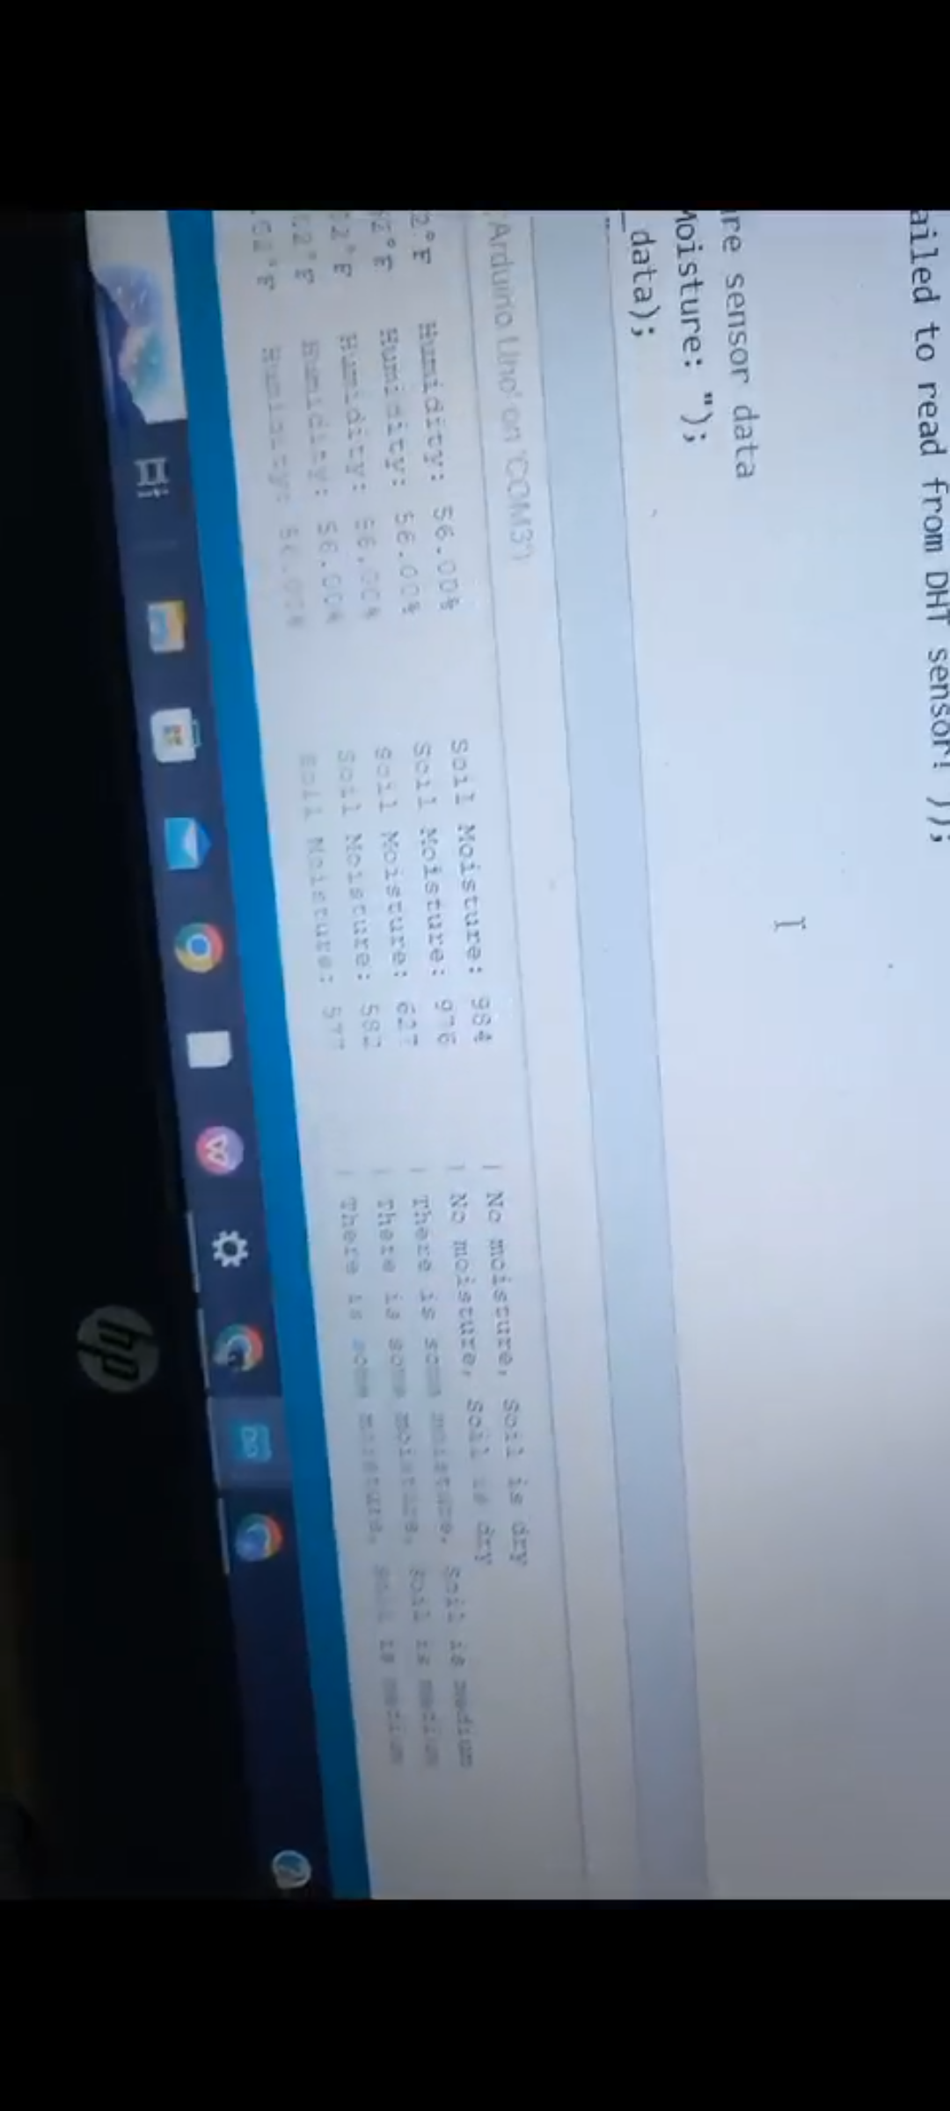
OUTPUT

Slide 12
Conclusion
Through the integration of temperature and humidity sensors with the 12V DC fan, the system effectively regulated the greenhouse environment, maintaining optimal conditions for plant growth.
The implementation of the moisture sensor and water pump automation demonstrated reliable and timely irrigation, responding dynamically to soil moisture variations
The use of solar panels ensured the system's sustainability and energy efficiency, reducing dependence on conventional power sources.

Slide 13
REFERENCES
[1] M. N. Hassan, A. S. Noor and S. I. Abdullah, “An automatic monitoring and control system inside greenhouse”, Green Energy and
Technology, 2015.
[2] J. Xiao, B. Jiang and K. J. Ming, “Design for wireless temperature and humidity monitoring system of the intelligent greenhouse”,
International Conference on Computer Engineering and Technology, Volume 3, pp. 59-63, 2010.
[3] Q. M. Vu, “Automated wireless greenhouse management system”, unpublished.
[4] M. H. Khan and M. M. Alom, “Greenhouse effect in Bangladesh-Environmental rules and regulations perspective”, Journal of
Multidisciplinary Engineering Science and Technology, Volume 2, Issue 1, pp. 283-285, January-2015.
[5] S. Athukorala, I. Weeraratne and R. Ragel, “Affordable real-time environment monitoring system for greenhouses”, Proceedings
of the 1st Manufacturing & Industrial Engineering Symposium, October 2016.
[6] Data Acquisition Of Greenhouse Using Arduino - Journal Of Babylon University/Pure And Applied Sciences/ No.(7)/ Vol.(22):
2014.
[7] Greenhouse Automation System Using Psoc 3 - Journal Of Information, Knowledge And Research In Electronics And
Communication Engineering.

Slide 14
THANK YOU

